Slide 1

Reactive Programming – From OOP to FRP
By Praseed Pai K.T.

Slide 2
About the Presenter
Co-Author of Books, “ .NET Design Patterns” and “C++ Reactive Programming” (writing) for Packt Publishing
Has Written a university level accredited paper on “Ontology”
Has created a course on “Philosophical Tools for Software Engineering” ( Presented @ Rubyconf India – Preconference)
Presented in more than 200 events
“Father” of SLANG Compiler Infrastructure
Slang4.net,Slang4Jvm, Slang4CPP (LLVM),SlangJs,
Slang4Py, Slang4VB.net
A budding expert on comparative philosophy (Indian/Western)
A Critique of Digital Solutioning and Technology Fads
Sr. Solutions Architect @ UST Global
-

Slide 3
Who is an Architect?
Architect (n) – Any person who has “fooled” around in the Software Industry for sizeable time (ever shrinking span) who is past his prime,as a Programmer Or Engineer,Systematically moved up in the hierarchy to obey “Peter Principle”.
-

Slide 4
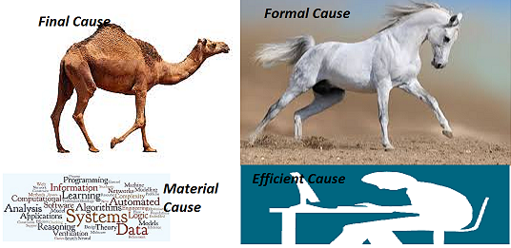
Perils of “Polyglot Programming”
-

Slide 5
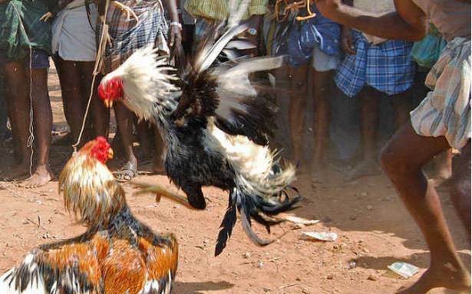
Hackathons – Is Programming a Combat sport?
-

Slide 6
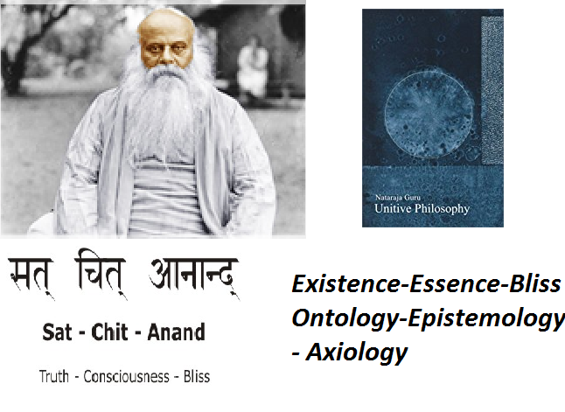
A Travel and Its aftermath
-

Slide 7
Why this session?
.
SAT | CHIT | ANANDA
Existence | Essence | Bliss
Ontology | Epistemology | Axiology
Who am I? | What Can I know? | What should I do?
Matter | Mind | Bliss
Structure | Behavior | Function

Slide 8
Three Pillars of any System
Structure,Behvior and Function are three pillars of the system
How these things appear in Economics?
How these things appear in Cognitive Psychology?
How these things appear in Computer Programming?

Slide 9
OOP – A quick introduction
A class has got a structure ( instance variable ) and behaviors ( methods ) to provide some functionality
For large programs , Structure and Behavior needs to be separated for SOC

Slide 10
OOP – Core Concepts
Abstraction, Encapsulation , Polymorphism, Inheritance
Interface and abstract classes
Factory Method, Template method , Prototype, Abstract Factory, Chain of Responsbility

Slide 11
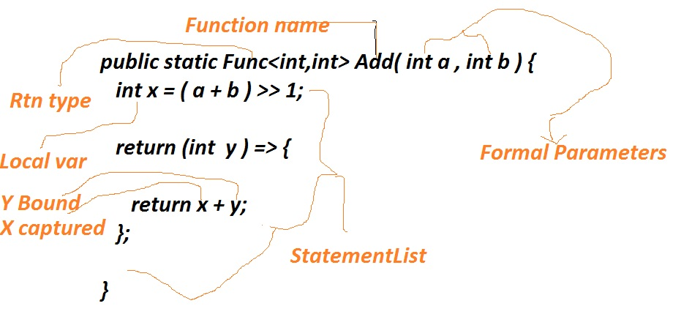
FP – Prologue

Slide 12
FP – A quick introduction
LISP is one of the oldest functional programming language
ML is the first typed functional programming language
The Lambda Calculus and FP
C# - an Object/Functional Programming language

Slide 13
FP – Core Concepts
FP is Programming with Pure Functions
Immutability , Side effects, Composition, Map/Reduce, Behavioral Parametrization , Variable Capture, Referential Transparency, Currying etc

Slide 14
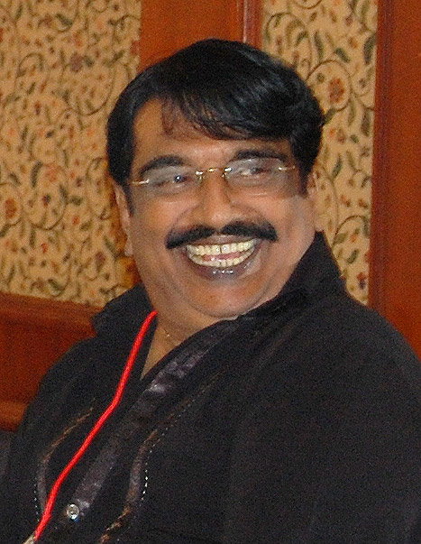
Comparitive Study of Programming Languages
In India, it is like this, I do not know how it is in Punjab?
- Punjabi House

Slide 15
OOP – What is the Essence?
Which is the canonical structure of a OOP program?

Slide 16
The Answer
Hierarchical Structures
They are modelled using Gang of Four Composite Pattern
The Composite models Part/Whole Hierarchy
The Composite/Visitor duo

Slide 17

Patterns are Golden Hammers – at least for some

Slide 18
The Composite/Visitor Pair from OOP
The Hierarchies are modelled using Composites (Structural)
Processing Composites through Visitor ( Behavior)
Evaluation of Expression using AST (Structural ) and Visitor
Directory Traversal and Processing using Composite/Visitor
Problems with the Composite/Visitor

Slide 19
The Problem with Composite/Visitor and its Rectification
The Visitor needs to understand the structure of the Composites
Is there any Pattern which helps us to navigate the content in a Structure agnostic manner?
Flattening the Composite and navigation of the data using Iterator pattern
Demerits of Iterator Pattern

Slide 20
Reversing the Gaze through Observable/Observer
The Fire/Forget solution to the Blocking problem
Notifcation to people who have subscribed
Threads, Pools and Asyncrhony management
Scheduling Execution

Slide 21
In Short, the Reactive Programming model is
Modelling Hierarchical Structures using the Composite
Behavioral processing using the Visitor Pattern
Flattening the Hierarchy and navigating them through Iterator
Notification to the subscribers using Observable/Observer pattern
Functional Composition and Immutability
Schedulers and Asychrony

Slide 22
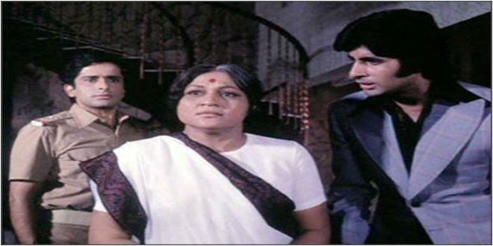
Who is more important?
Aaj mere paas building(C++) hai, property(C#) hai ,
bank balance (Java) hai, bungla(Python) hai,gaadi hai(PHP)
Kya hai, Kya hai tumhare paas?
....Mere Paas Maa (JavaScript) hai

Slide 23
Rx.Net
Example One
Example Two
Example Three
Example Four
Example Five
Example Six

Slide 24
Q&A
If any!

